Slide 1
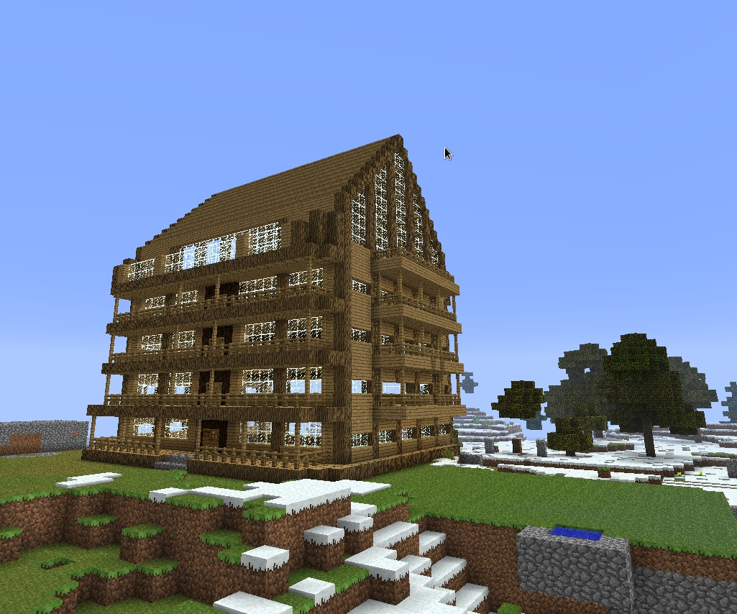
Overview of 3D Graphics Programming
Henry Wise Wood
Math Club
March 12, 2012

Slide 2
Components of a 3D game
Input handling
Physics: movement
Collision detection
Networking (multiplayer games only)
A.I. decisions
3D drawing
Sounds

Slide 3
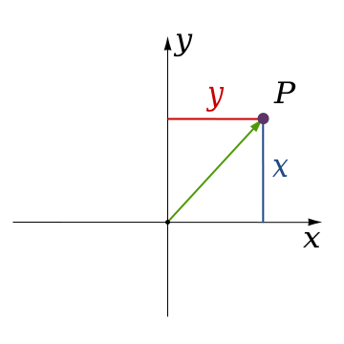
2D coordinate systems
Standardized in the math world
NOT standardized in the computer graphics world
Sometimes, the same game engine may use different 2D coordinate systems for different purposes

Slide 4
3D coordinate systems
Left-handed | Modified left-handed | Right-handed
Used by DirectX (Windows / Xbox) | Used by Sony PlayStation | Used by OpenGL and Nintendo
Z
Y
Y
Z
X
X
X
Y
Z
Source: http://softimage.wiki.softimage.com/xwalkdocs/ftk_TemplateRef_SI_CoordinateSystem.htm

Slide 5
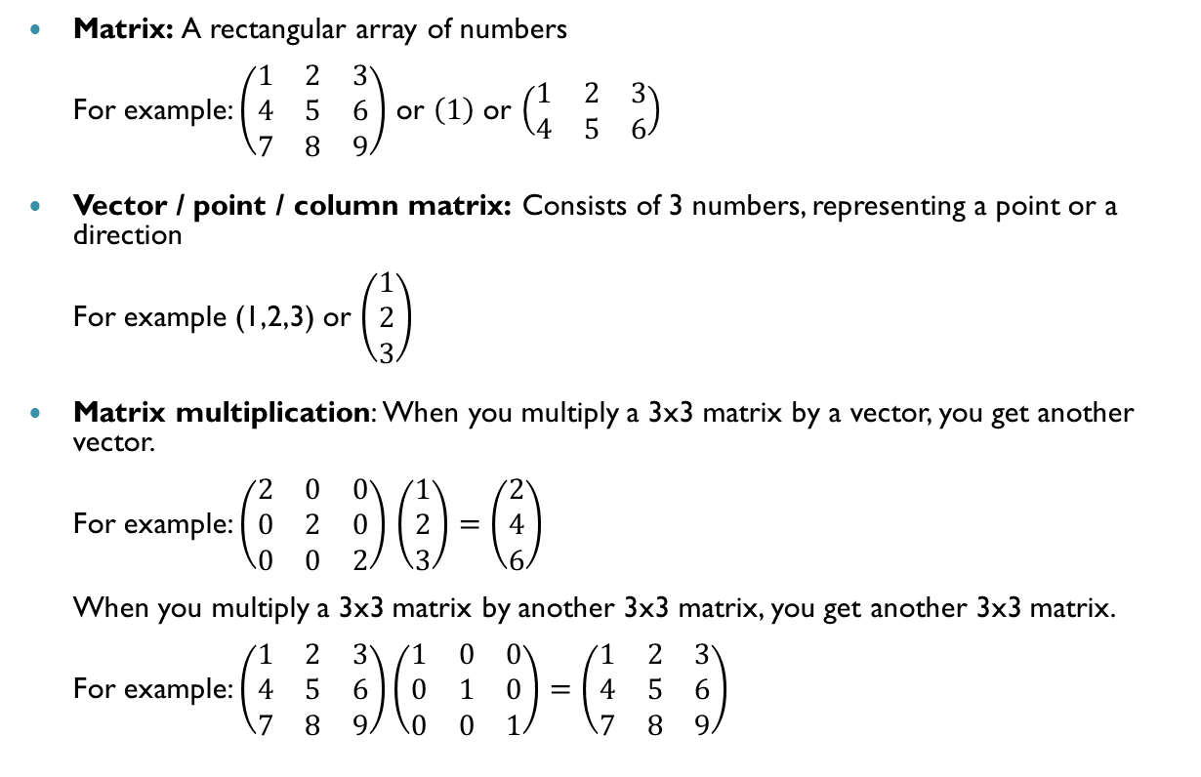
Basic terminology of 3D graphics
Matrix: A rectangular array of numbers
For example: $\left(\begin{matrix}1 & 2 & 3 \\ 4 & 5 & 6 \\ 7 & 8 & 9\end{matrix}\right)$ or $\left(1\right)$ or $\left(\begin{matrix}1 & 2 & 3 \\ 4 & 5 & 6\end{matrix}\right)$
Vector / point / column matrix: Consists of 3 numbers, representing a point or a direction
For example (1,2,3) or $\left(\begin{matrix}1 \\ 2 \\ 3\end{matrix}\right)$
Matrix multiplication: When you multiply a 3x3 matrix by a vector, you get another vector.
For example: $\left(\begin{matrix}2 & 0 & 0 \\ 0 & 2 & 0 \\ 0 & 0 & 2\end{matrix}\right)$ $\left(\begin{matrix}1 \\ 2 \\ 3\end{matrix}\right)=\left(\begin{matrix}2 \\ 4 \\ 6\end{matrix}\right)$
When you multiply a 3x3 matrix by another 3x3 matrix, you get another 3x3 matrix.
For example: $\left(\begin{matrix}1 & 2 & 3 \\ 4 & 5 & 6 \\ 7 & 8 & 9\end{matrix}\right)\left(\begin{matrix}1 & 0 & 0 \\ 0 & 1 & 0 \\ 0 & 0 & 1\end{matrix}\right)=\left(\begin{matrix}1 & 2 & 3 \\ 4 & 5 & 6 \\ 7 & 8 & 9\end{matrix}\right)$

Slide 6
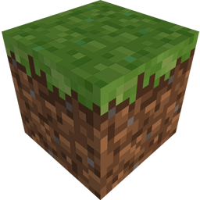

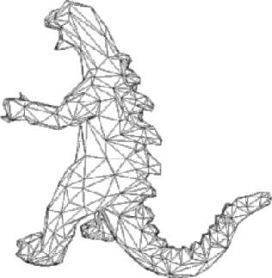
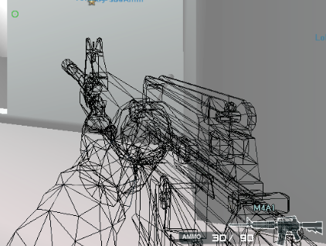
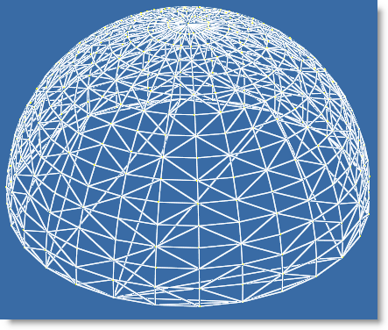
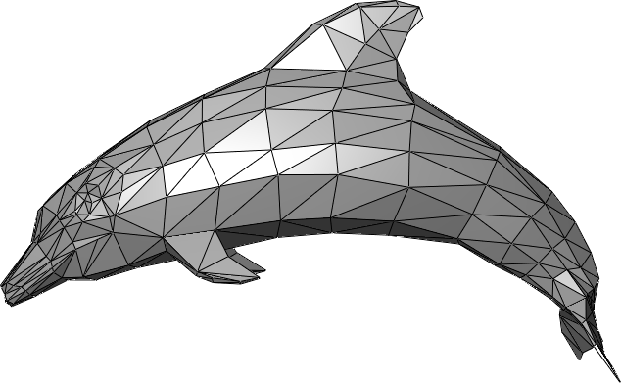
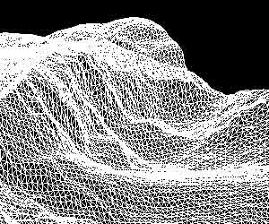
3D objects
Every 3D object is basically made of 2 things:
  Triangles
  Zero or more 2D textures
  (images drawn onto the triangles)

Slide 7
Vertices
A vertex is a point in space with some additional properties attached
Basically, each vertex consists of:
  Cartesian coordinates (x,y,z)
  Color (a,r,g,b)
  Texture coordinates (u,v)
Objects can share vertices
as long as these properties
are the same
Y
Z
(5,3,2)
3
2
X
5

Slide 8
Vertex sharing - example
Y
Y
(0,2,red)
(2,2,red)
(0,2,green)
(2,2,green)
(1,1,red)
(1,1,red) and (1,1,green)
X
X
(0,0,red)
(2,0,red)
(0,0,red)
(2,0,red)
5 vertices | 6 vertices

Slide 9

Textures
(0,0)
U-axis
A texture is an image drawn onto a triangle
A single triangle can use only part of a texture
Every vertex is assigned a texture coordinate
(u, v)
The texture coordinate tells the graphics card which part of the texture should be used to draw the triangle
(1,1)
V-axis
Y
(x=0,y=1,u=0.5,v=1)
X
(x=0,y=0,u=0.5,v=0)
(x=1,y=0,u=0,v=0)

Slide 10
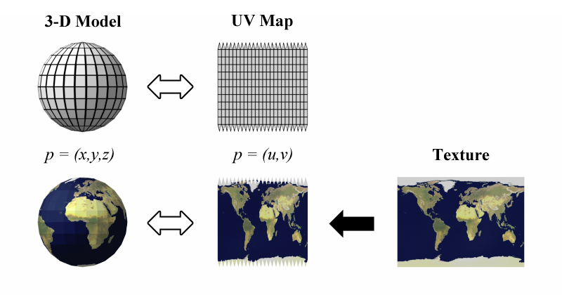
Textures

Slide 11
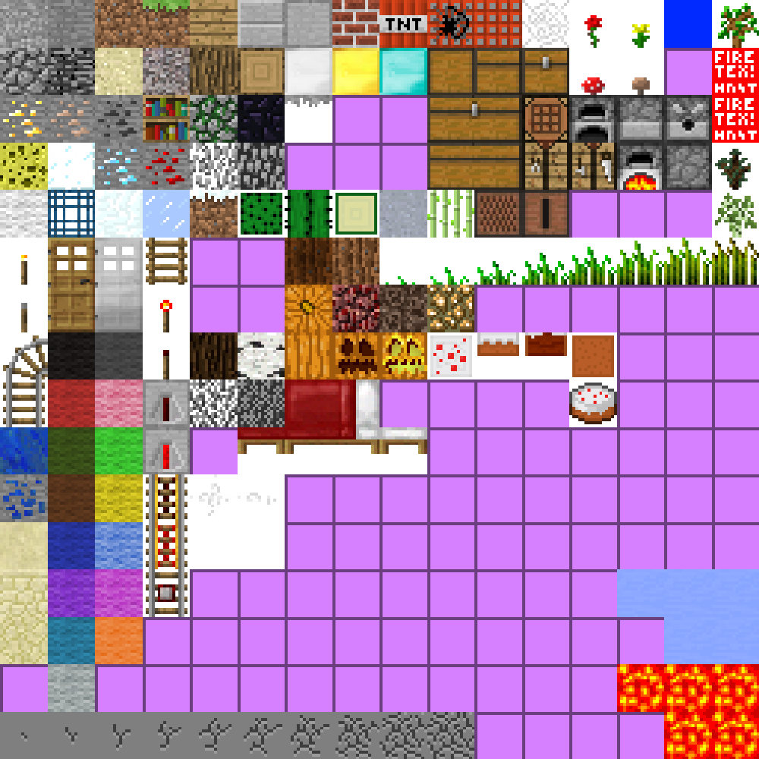
Textures
(x=1, y=1, z=1, color=green, u=0, v=0)
Z
Y
X
Color of texture is combined with color of vertex
This cube requires 24 vertices and 12 triangles

Slide 12
Graphics pipeline
The process by which 3D objects are drawn is known as the graphics pipeline
There are two main types of graphics pipelines: fixed-function and shader
Fixed-function: The graphics card performs a fixed series of steps to render the scene
Shader: The programmer writes a program (shader) that runs on the graphics card to render the scene. Using shaders, you can create more realistic effects like water ripples/reflection
Side note: Shaders have many uses outside of 3D graphics, where they can be used to perform general computing tasks (e.g. Nvidia CUDA and OpenCL)

Slide 13
Fixed-function vertex pipeline
Simplified overview of steps
The vertices are multiplied by the world matrix, which transforms each vertex into its correct position
The vertices are multiplied by the projection matrix, which converts each 3D vertex into a 2D vertex to be displayed on the screen
Each triangle is rendered with its corresponding texture, using depth testing to determine which triangles are on top of others

Slide 14
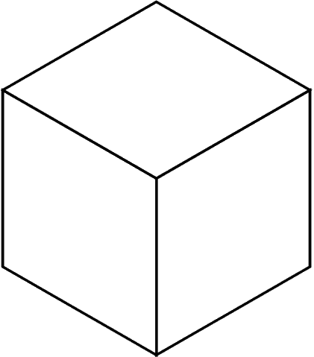
World matrix
Before rendering, each vertex is first transformed by the world matrix (also called the modelview matrix)
The world matrix is supplied by the programmer and can be changed at any time
By changing the world matrix, we can rotate, scale, and translate each point in the same way
That way, we don’t have to re-send all our vertices to the video card if we just want to transform all of them in the same way
The same set of vertices can be used to draw all 5 cubes. Each cube is simply drawn with a different world matrix
Only 8 vertices required, not 40

Slide 15
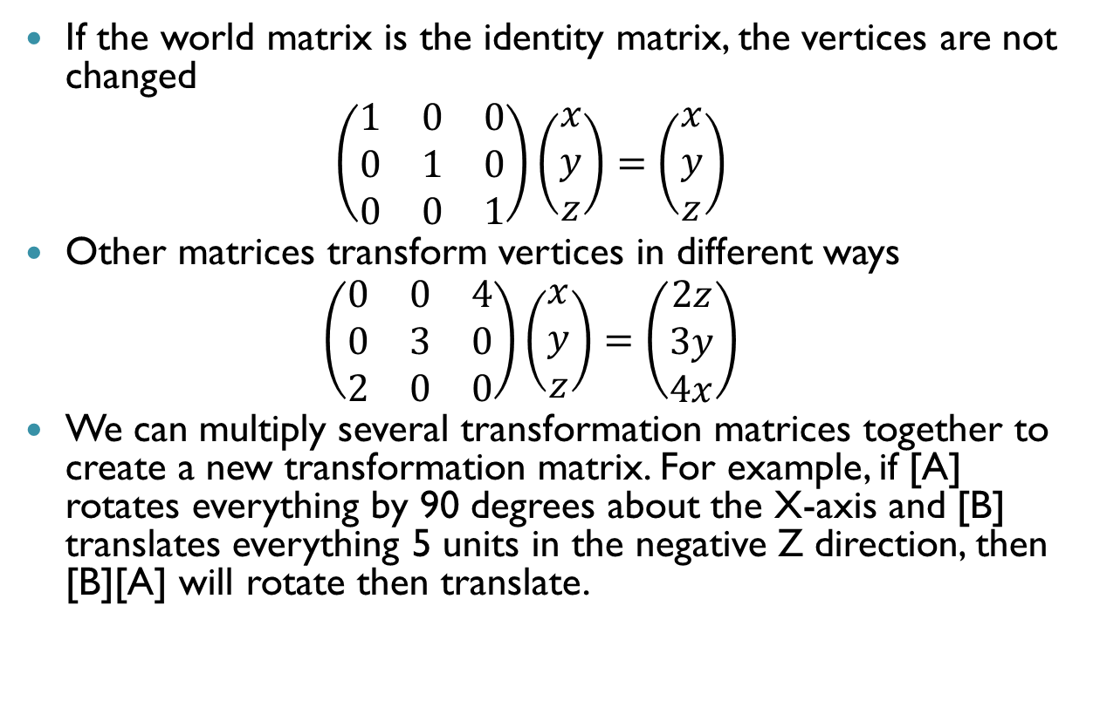
World matrix
If the world matrix is the identity matrix, the vertices are not changed
$$\left(\begin{matrix}1 & 0 & 0 \\ 0 & 1 & 0 \\ 0 & 0 & 1\end{matrix}\right)\left(\begin{matrix}x \\ y \\ z\end{matrix}\right)=\left(\begin{matrix}x \\ y \\ z\end{matrix}\right)$$
Other matrices transform vertices in different ways
$$\left(\begin{matrix}0 & 0 & 4 \\ 0 & 3 & 0 \\ 2 & 0 & 0\end{matrix}\right)\left(\begin{matrix}x \\ y \\ z\end{matrix}\right)=\left(\begin{matrix}2z \\ 3y \\ 4x\end{matrix}\right)$$
We can multiply several transformation matrices together to create a new transformation matrix. For example, if [A] rotates everything by 90 degrees about the X-axis and [B] translates everything 5 units in the negative Z direction, then [B][A] will rotate then translate.

Slide 16
World matrix: Camera
To implement a camera, we have to move all the objects in the opposite of the direction of the camera using the world matrix
For example, if the camera rotates to the right, we have to rotate all of the vertices towards the left

Slide 17
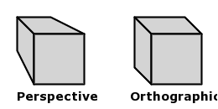
Projection matrix
Next, each vertex is transformed by a projection matrix
The projection matrix transform each 3D point into 2D points that can be displayed on the screen
There are two main types of projection matrices, orthographic and perspective
Perspective: Objects appear smaller when further away
Orthographic: Objects are the same size no matter what

Slide 18
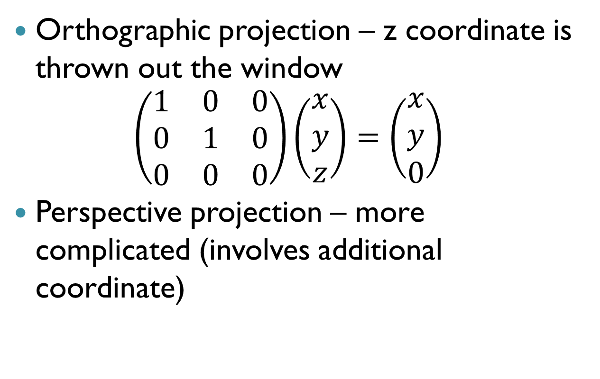
Projection matrix
Orthographic projection – z coordinate is thrown out the window
$$\left(\begin{matrix}1 & 0 & 0 \\ 0 & 1 & 0 \\ 0 & 0 & 0\end{matrix}\right)\left(\begin{matrix}x \\ y \\ z\end{matrix}\right)=\left(\begin{matrix}x \\ y \\ 0\end{matrix}\right)$$
Perspective projection – more complicated (involves additional coordinate)

Slide 19
Depth testing
How does the graphics card decide which triangles are hidden by others?
The most common solution is called depth testing (also known as z-buffering)
For every frame, the graphics card must keep track of the nearest seen Z value for every single pixel on the screen
When a triangle is drawn, the Z value of each pixel is compared against the value in the Z buffer and will only be drawn if it is nearer
Y
Z
X

Slide 20
Depth testing
2m away
1m away
3m away
2m away
Pixels here not drawn
1m away
3m away

